Slide 1
SUBMITTED BY:
AJAY MAHARJAN (HCE075BCT006)
ASHISH RAI (HCE075BCT042)
NIBENDRA BAJRACHARYA (HCE075BCT015)
SUJAN MAHARJAN (HCE075BCT037)
A FINAL YEAR MAJOR PROJECT
ON
IMAGE COLORIZATION AND INPAINTING USING CONVOLUTIONAL NEURAL NETWORK (CNN) AND GENERATIVE ADVERSARIAL NETWORKS (GAN)
[CT 707]
SUBMITTED TO:
DEPARTMENT OF ELECTRONICS AND COMPUTER ENGINEERING

Slide 2
Introduction
Image Colorization and Inpainting underlie Image Processing using deep learning technique.
Improve the quality of an images
Image Colorization estimates the RGB color
Recover the lost fragment or remove the object completely.

Slide 3
Problem Statement
Difficult to restore or recover corrupt image.
Requires a photoshop skill to add color which is a tedious process.

Slide 4
Objectives
To colorize the grayscale images and compare the accuracy of output colorized image with real image.
To reconstruct damaged parts or missing parts of image using GANs.

Slide 5
Scope and Applications
Converts monochrome image to make it more aesthetically appealing and perceptually meaningful.
Used for colorization purposes in the documentation image.
Used for recovering corrupted images as well as videos.

Slide 6
Requirement Analysis
Functional Requirements:
Login/Register
Upload images
Image Colorization
Image restoration
Download image

Slide 7
Non-Functional Requirements:
Reliable
Availability
Performance
Scalability
Maintainability
Security

Slide 8
Feasibility Study
Technical Feasibility - Hardware and software tools are within accessible boundaries.
Operational Feasibility - Simple and interactive interface and data drive.
Economic Feasibility - Only a computer is required to access the web application

Slide 9
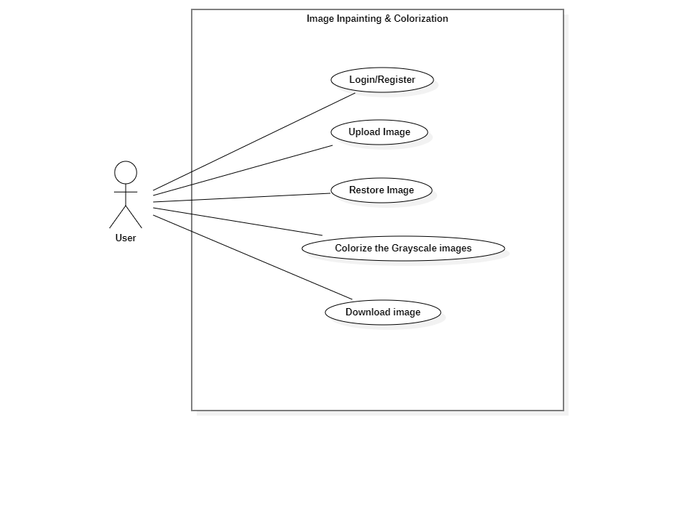
System Design
Use Case Diagram

Slide 10
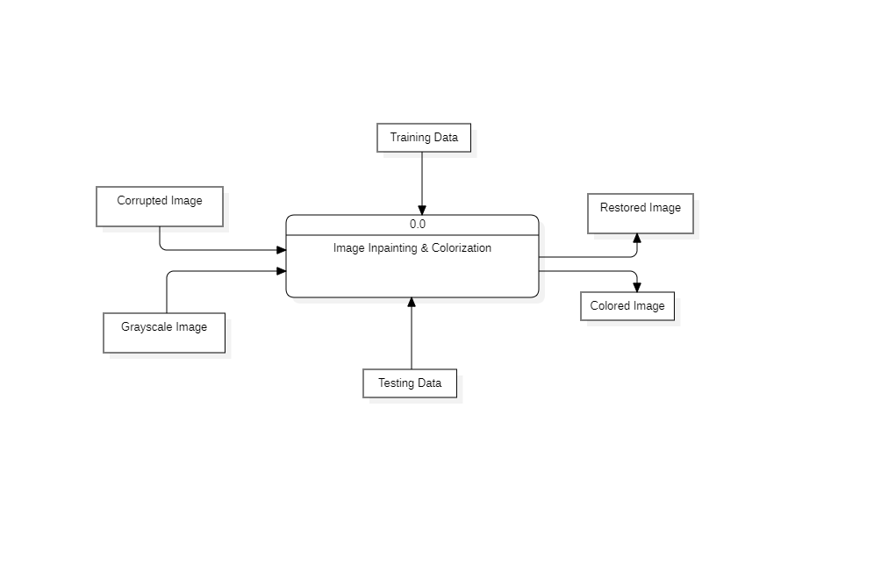
Data Flow Diagram Level 0

Slide 11
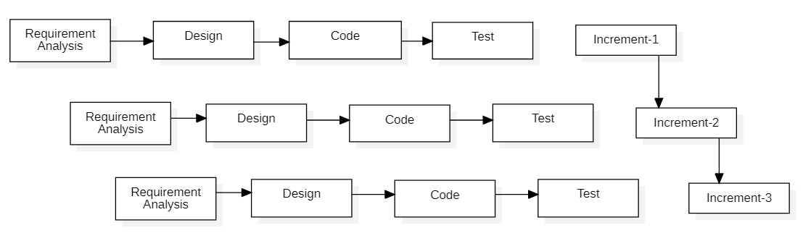
Methodology
Fig : Block diagram of incremental model

Slide 12
Image Inpainting
The main objective is to implement the Deep Conditional GAN on image inpainting.
GAN incorporates two neural networks:
A generator – it takes in the incomplete image as the input and generates a fake full image with the missing segment filled.
A discriminator – it tries to distinguish generated images from original full images.
They will operate on min-max algorithm which have some loss function.

Slide 13
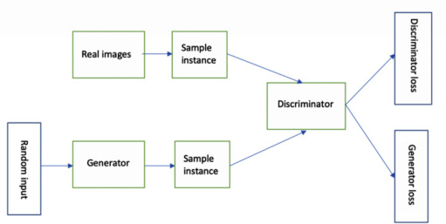

Slide 14
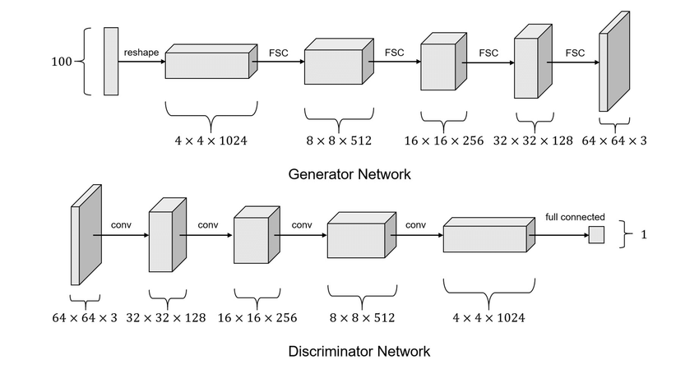
Network Architecture

Slide 15
The network architecture of the generator is based on U-Net.
The generator consists of the convolutional layers in encoder-decoder fashion, that generates the recovered images from cropped images.
Encoder, a shrinking network that shrinks the tensor layer by layer.
Decoder, a expanding network that expands the depth of the tensor layer by layer.
The final output of the generator is the recovered image from the cropped image, which is of the original size.
The recovered image of the generator is then injected into the discriminator, that determines whether the image is real or fake.

Slide 16
Image Colorization
Conditional GAN
Generative models composed of two opposing parts - a generator and a discriminator
Generator to be used is U-Net. Skip connections are also added.
Discriminator to be used is PatchGAN. Dropout layers will be used.

Slide 17
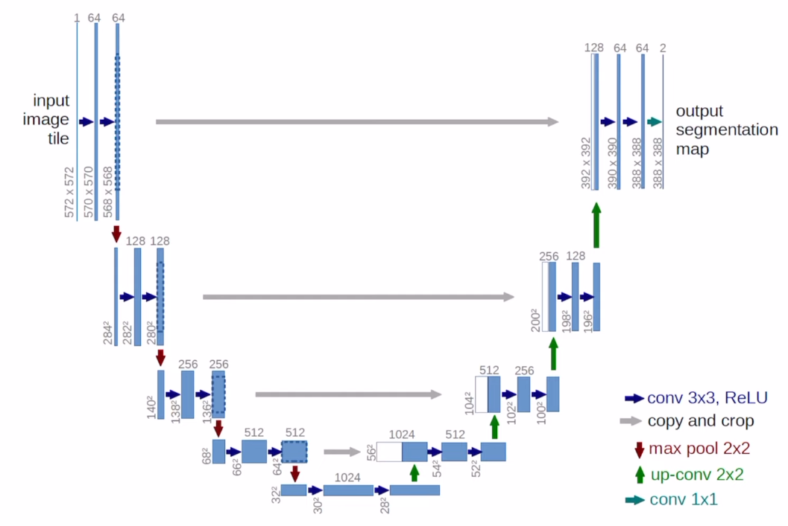

Slide 18
Color space
CIELAB (L,a,b) - to describe all visible colors
The L component stands for perceptual lightness with range [0, 100], i.e. it is the grayscale element.
The A component represents the color position between red and green, while the B component represents the color position between blue and yellow; both components have ranges [−128, 127].

Slide 19
Objective function
Condition GAN :
Mean Absolute Error (L1 loss) :
Final objective function :

Slide 20
Frontend development:
JavaScript – React
CSS
Backend development:
Node JS
Python

Slide 21
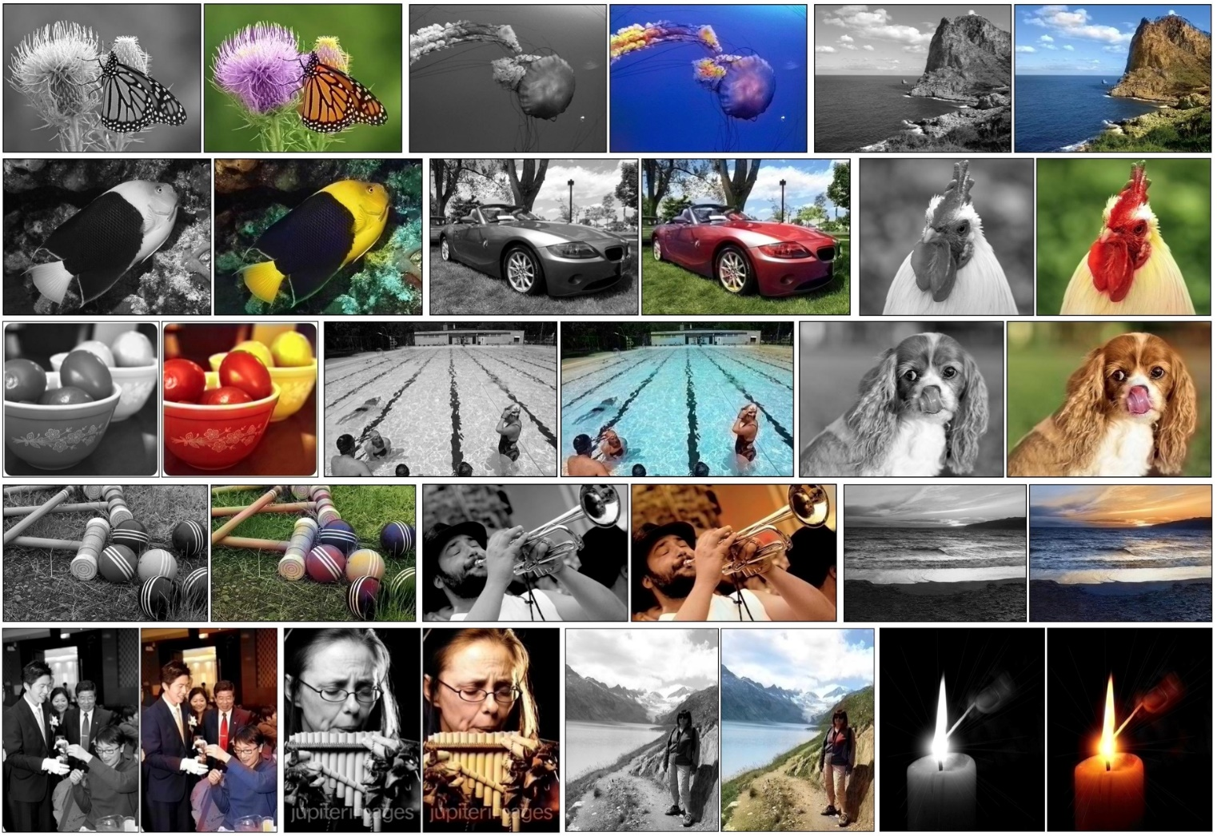
EXPECTED OUTCOMES
Image Colorization

Slide 22
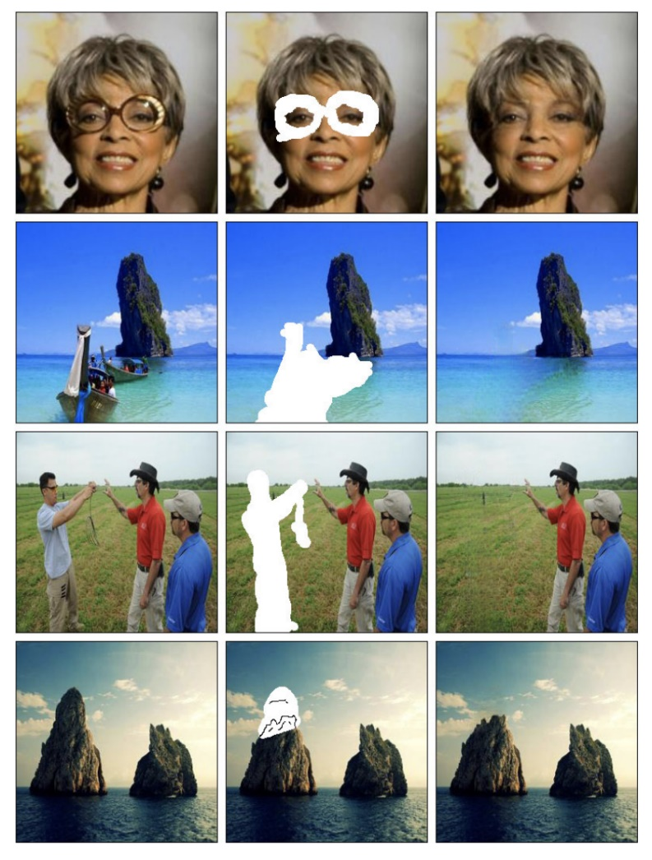
Image Inpainting

Slide 23
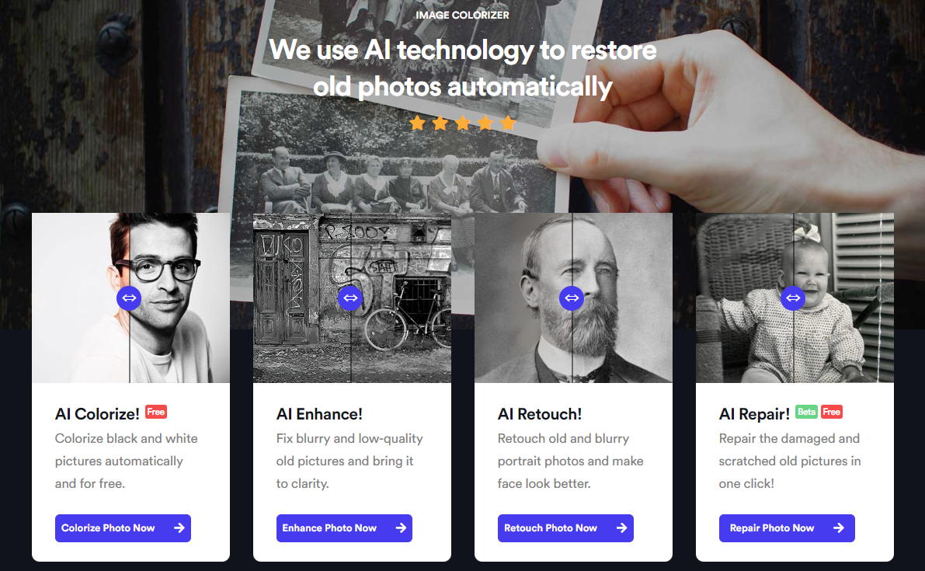
Website

Slide 24
References
[1] S. Salve, T. Shah, V. Ranjane, and S. Sadhukhan, "Automatization of coloring grayscale images using convolutional neural network," 2018.
[2] V. K. Putri and M. I. Fanany, "Sketch plus colorization deep convolutional neural networks for photos generation from sketches," pp. 1-6, 2017.
[3] H. H. Chen Y, "An improved method for semantic image inpainting with gans: progressive inpainting.," Neural Process Lett, p. 1355–1367, 2019.
[4] Vitoria P, Sintes J, Ballester C, "Semantic image inpainting through improved Wasserstein generative adversarial networks," 2018.
[5] Nazeri K, Ng E, Joseph T, Qureshi F, Ebrahimi M, "Edgeconnect: generative image inpainting with adversarial edge learning," 2019.
[6] Yuan L, Ruan C, Hu H, Chen D, "Image inpainting based on patch-GANs," 2019.

Slide 25
Thank You

